Slide 1
Christopher E Baker, MD
Assistant Professor, Diagnostic Radiologist
University of Massachusetts Medical Center
Interests: Cartooning
Christopher E Baker, MD

Slide 2
Christopher E Baker, MD
“Laughter is Good Medicine” wrote Norman Cousins. The physiological effects, both short and long-term, are well defined and amazingly beneficial. Laughing stimulates your heart, lungs, muscles and circulation. It decreases stress hormones, releases neuropeptides and endorphins. The really hard part is getting people to laugh.
I have been cartooning for 20 years. I am also a collector and have collected a large humor library from around the globe. I consider cartooning one of the highest art forms for its’ synthesis of art, the written word and timing.
Not everything is funny to everyone but there is nothing more satisfying than getting someone else to laugh, especially a sick patient.

Slide 3
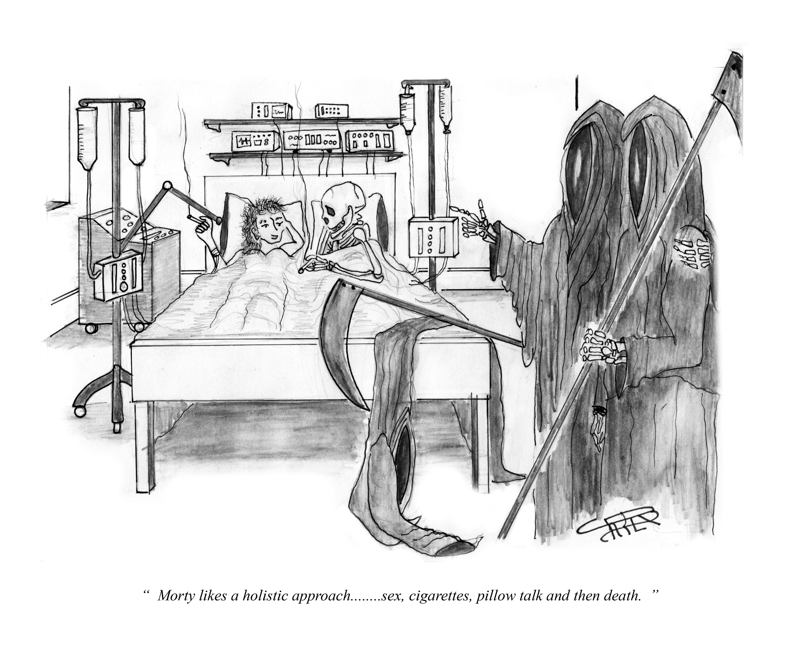

Slide 4
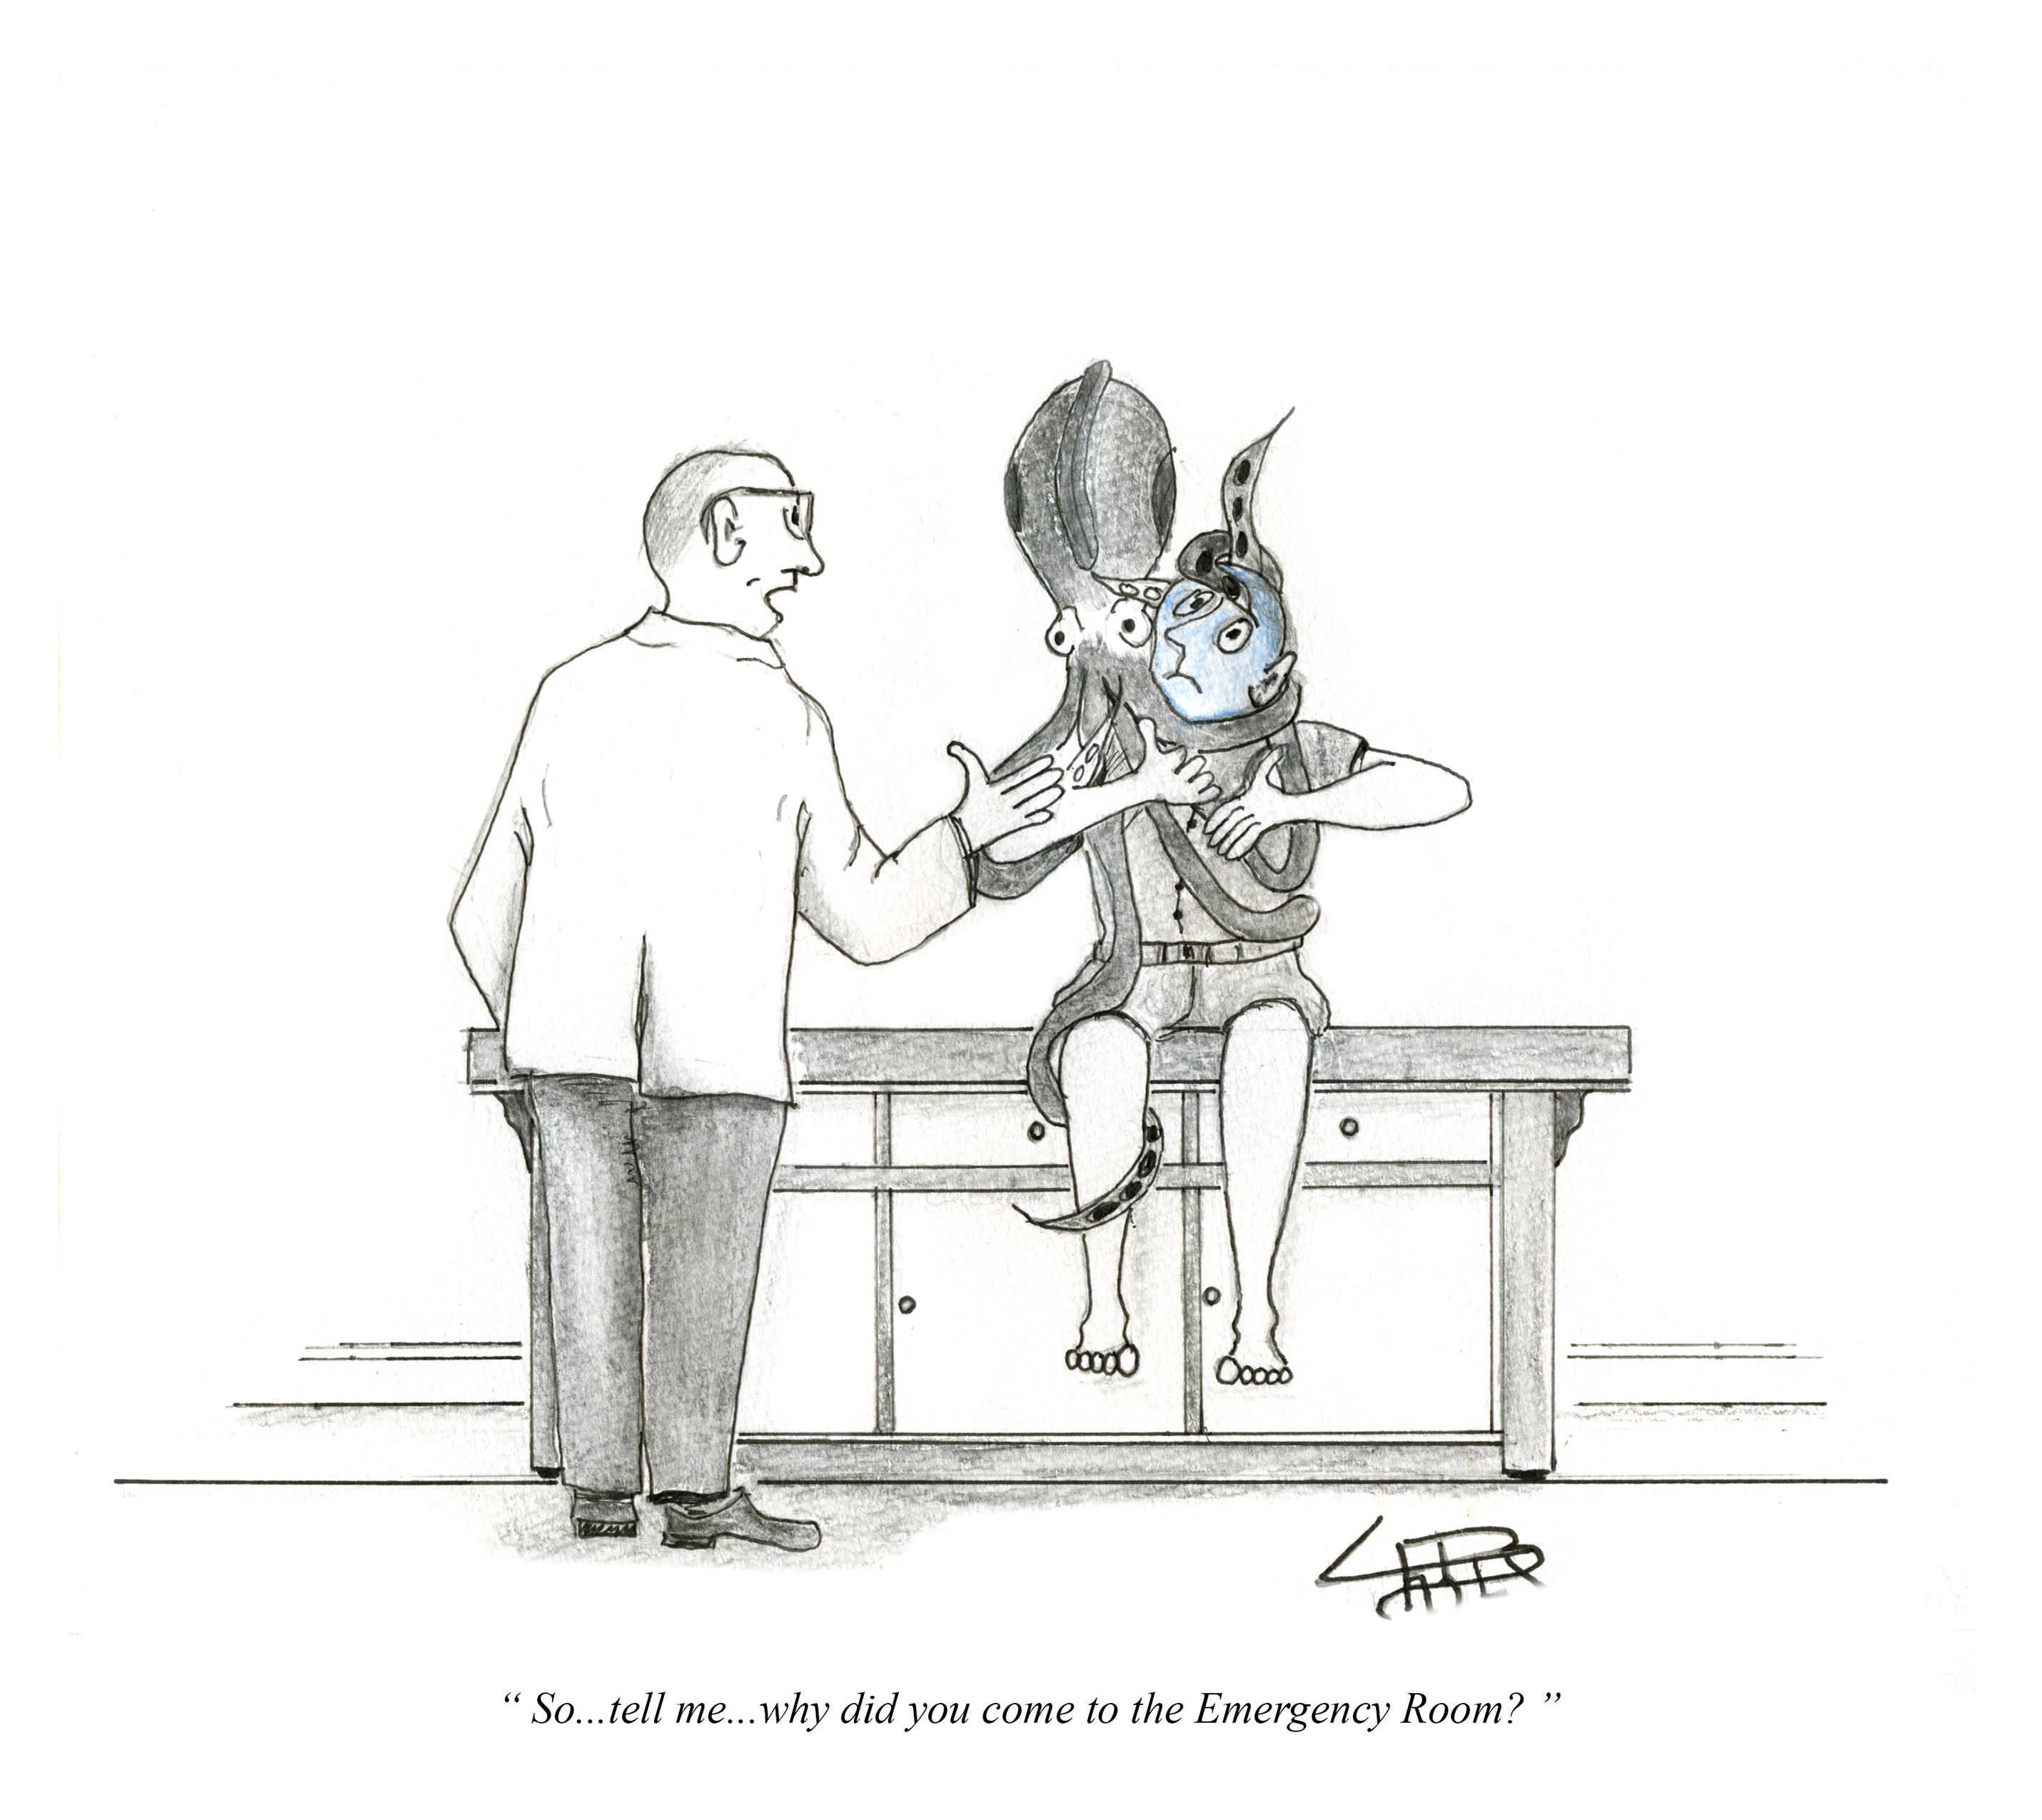

Slide 6
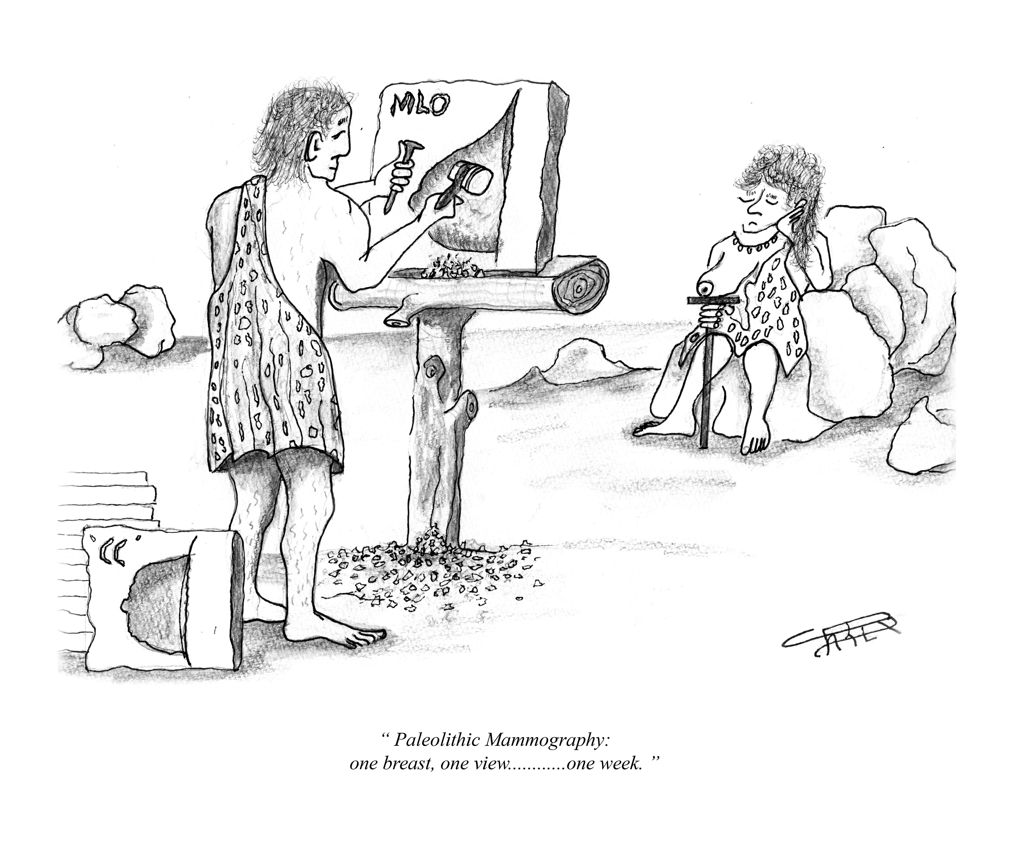

Slide 7
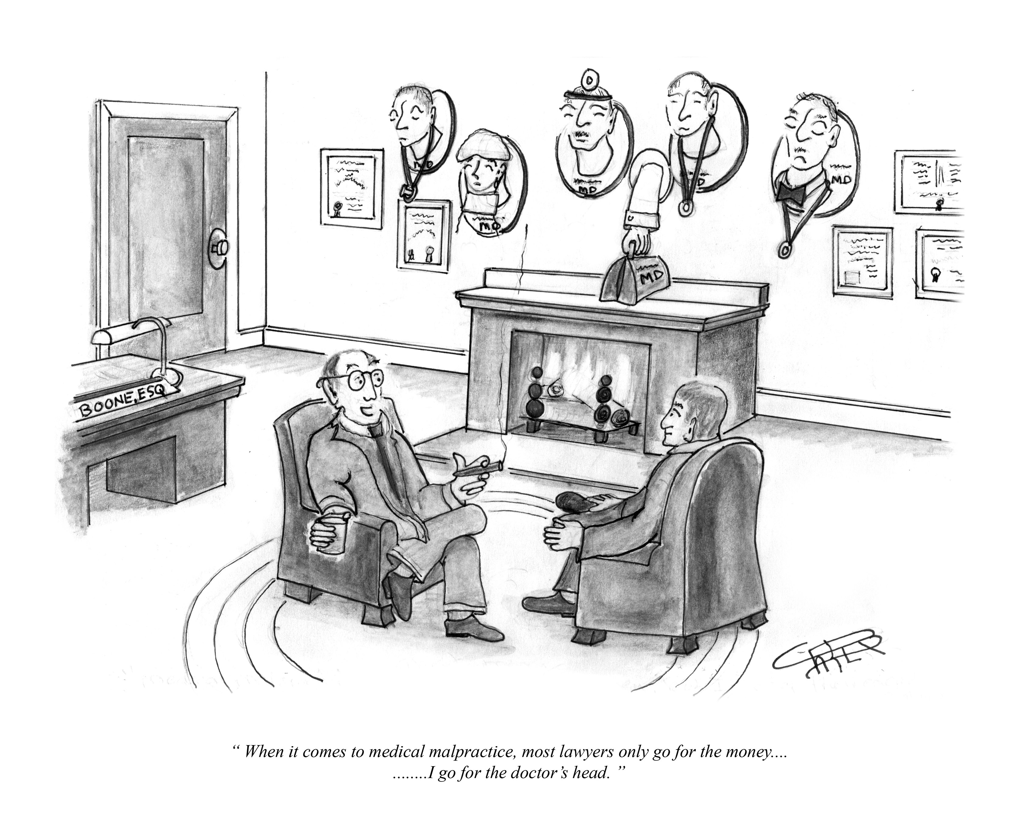

Slide 8
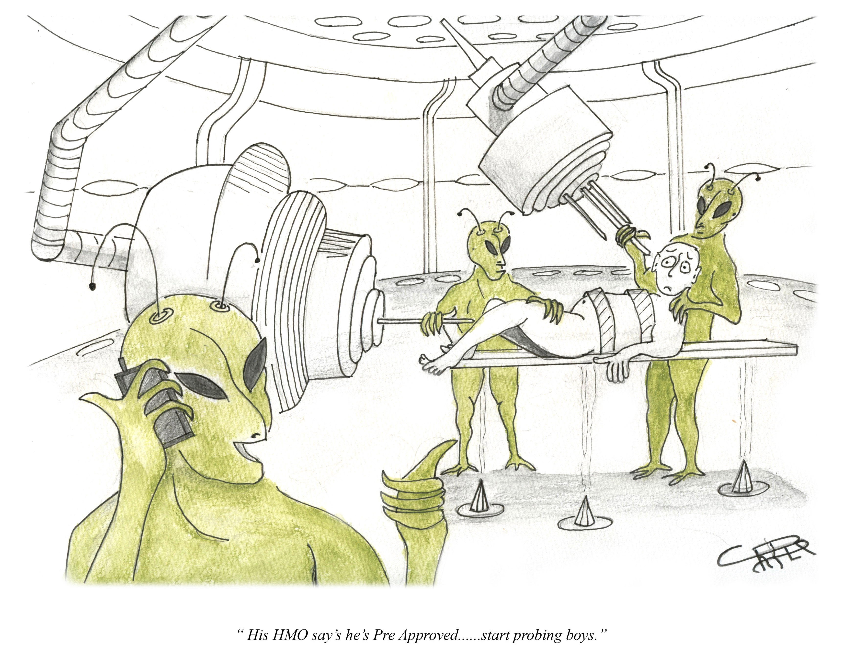

Slide 9
